Slide 1

Task 21
Data Manipulation with Pandas and NumPy
Name: Basel Amr Barakat
Email: baselamr52@gmail.com

Slide 2
Requirement One
Creating and Manipulating Pandas DataFrames

Slide 3
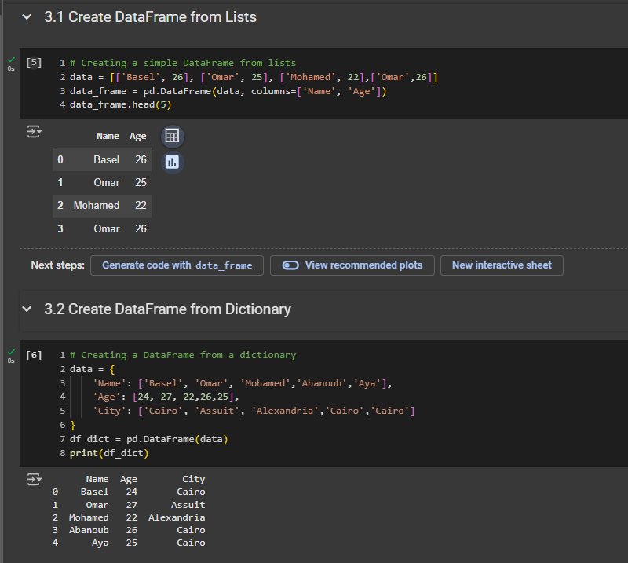
1.1 Create Dataframe from lists 1.2 Create Dataframe from Dictionary

Slide 4
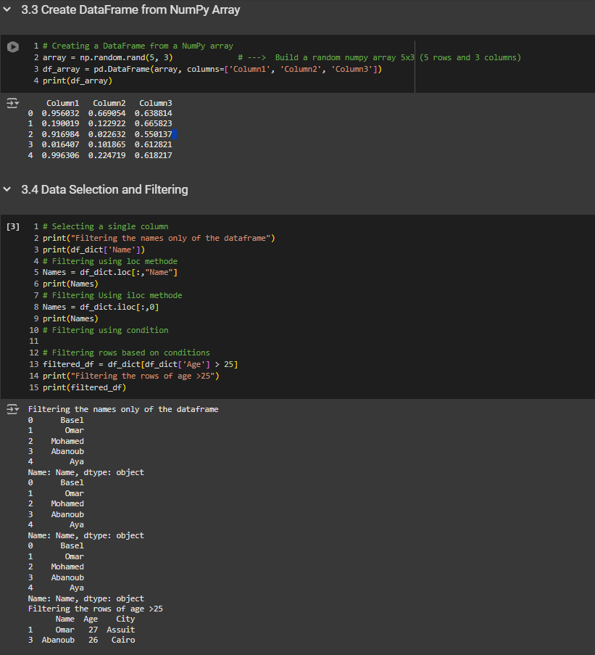
1.3 Create Dataframe from NumPy array 1.4 Data Selection and Filtering

Slide 5
Requirement Two
Handling Missing Data and Merging DataFrames

Slide 6
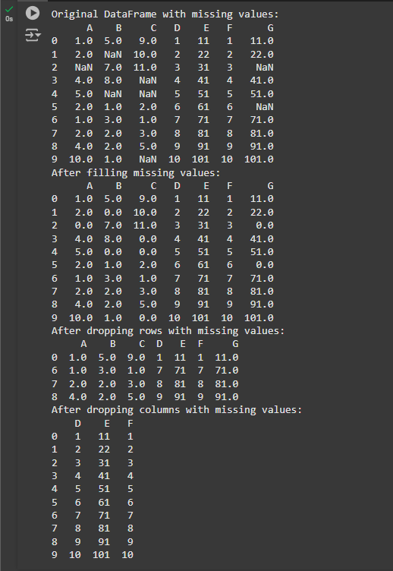
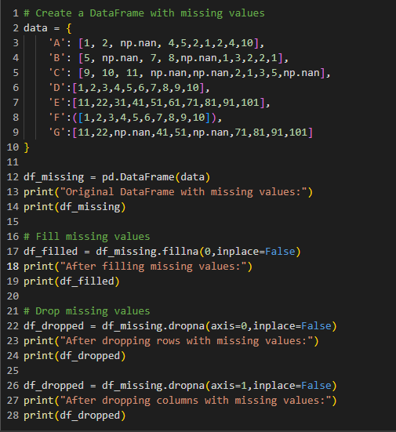
2.1 Handling Missing Data

Slide 7
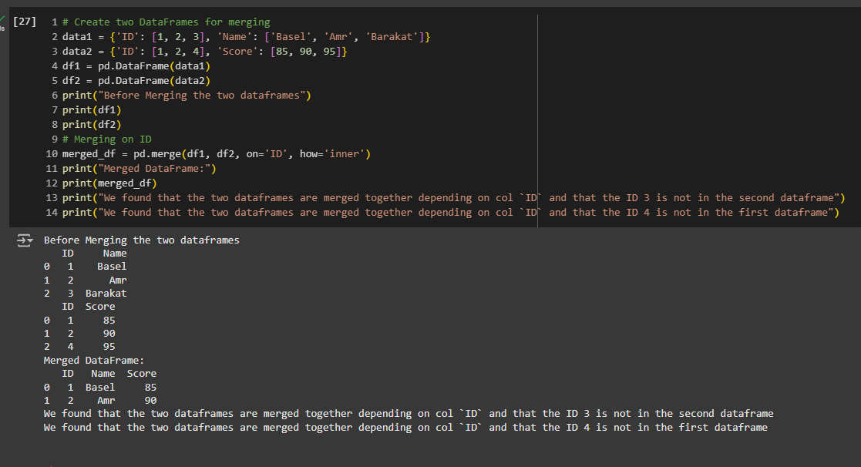
2.2 Merging Dataframes

Slide 8
Requirement Three
Combining Pandas and NumPy for Analysis

Slide 9
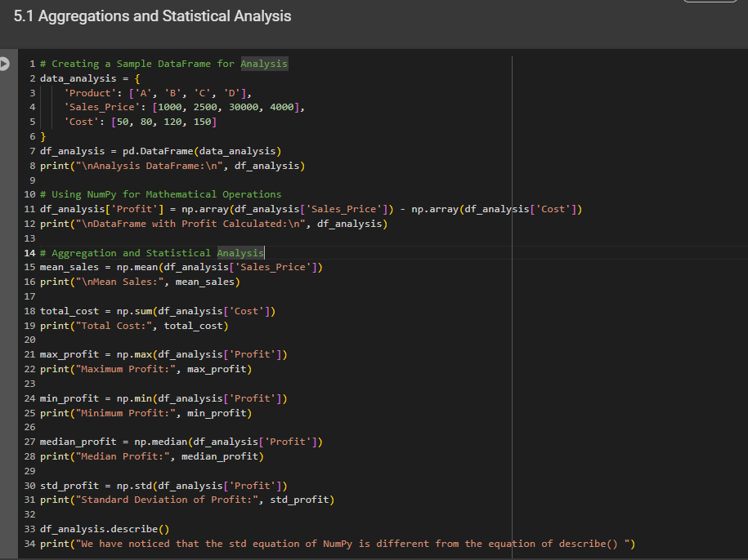
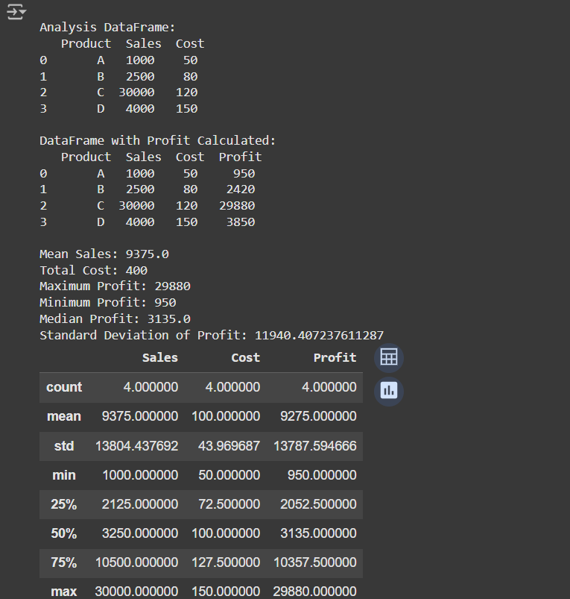
3.1 Aggregations and statistical Analysis

Slide 10
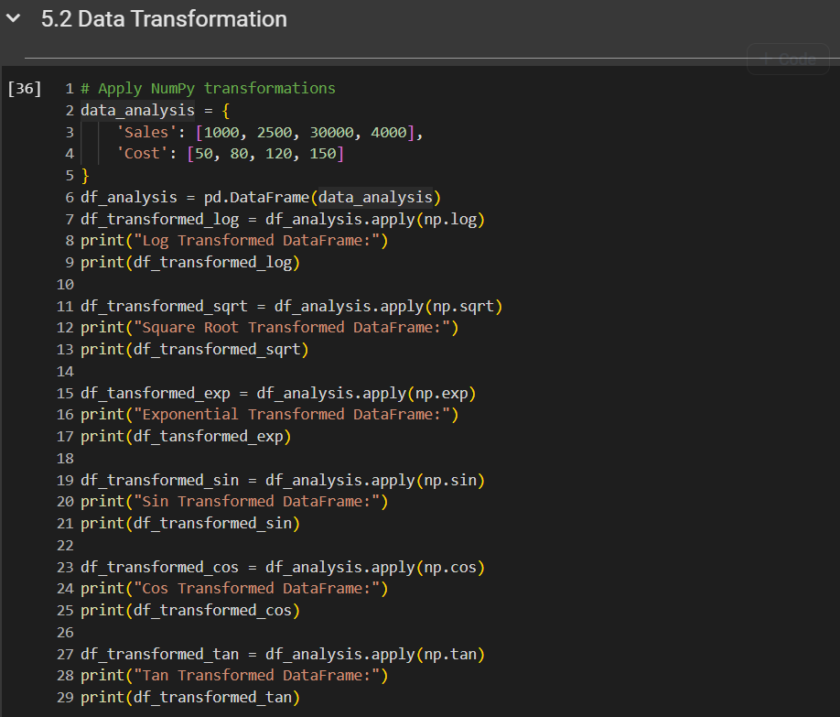
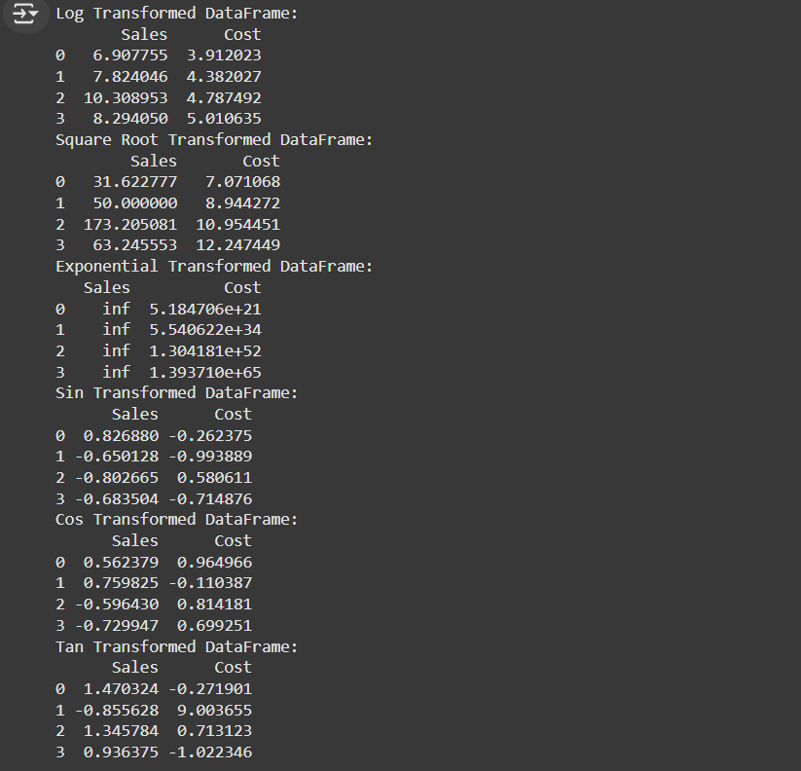
3.2 Data Transformation

Slide 11
Requirement Four “Extra”
Plotting

Slide 12
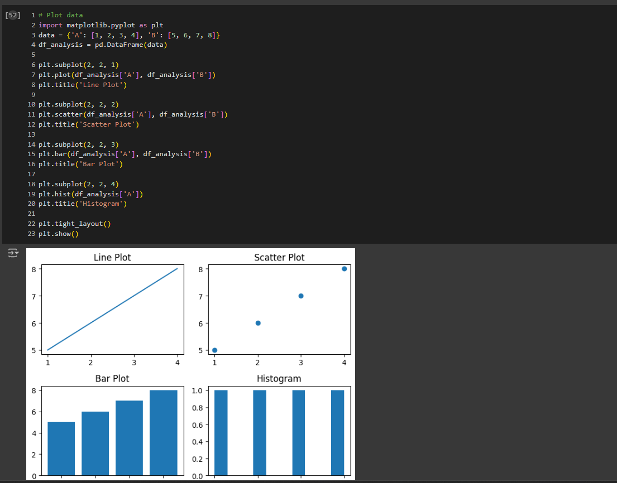
3.1 Aggregations and statistical Analysis

